Slide 1
AWS CodeWhisperer POC Executive Summary

Slide 2

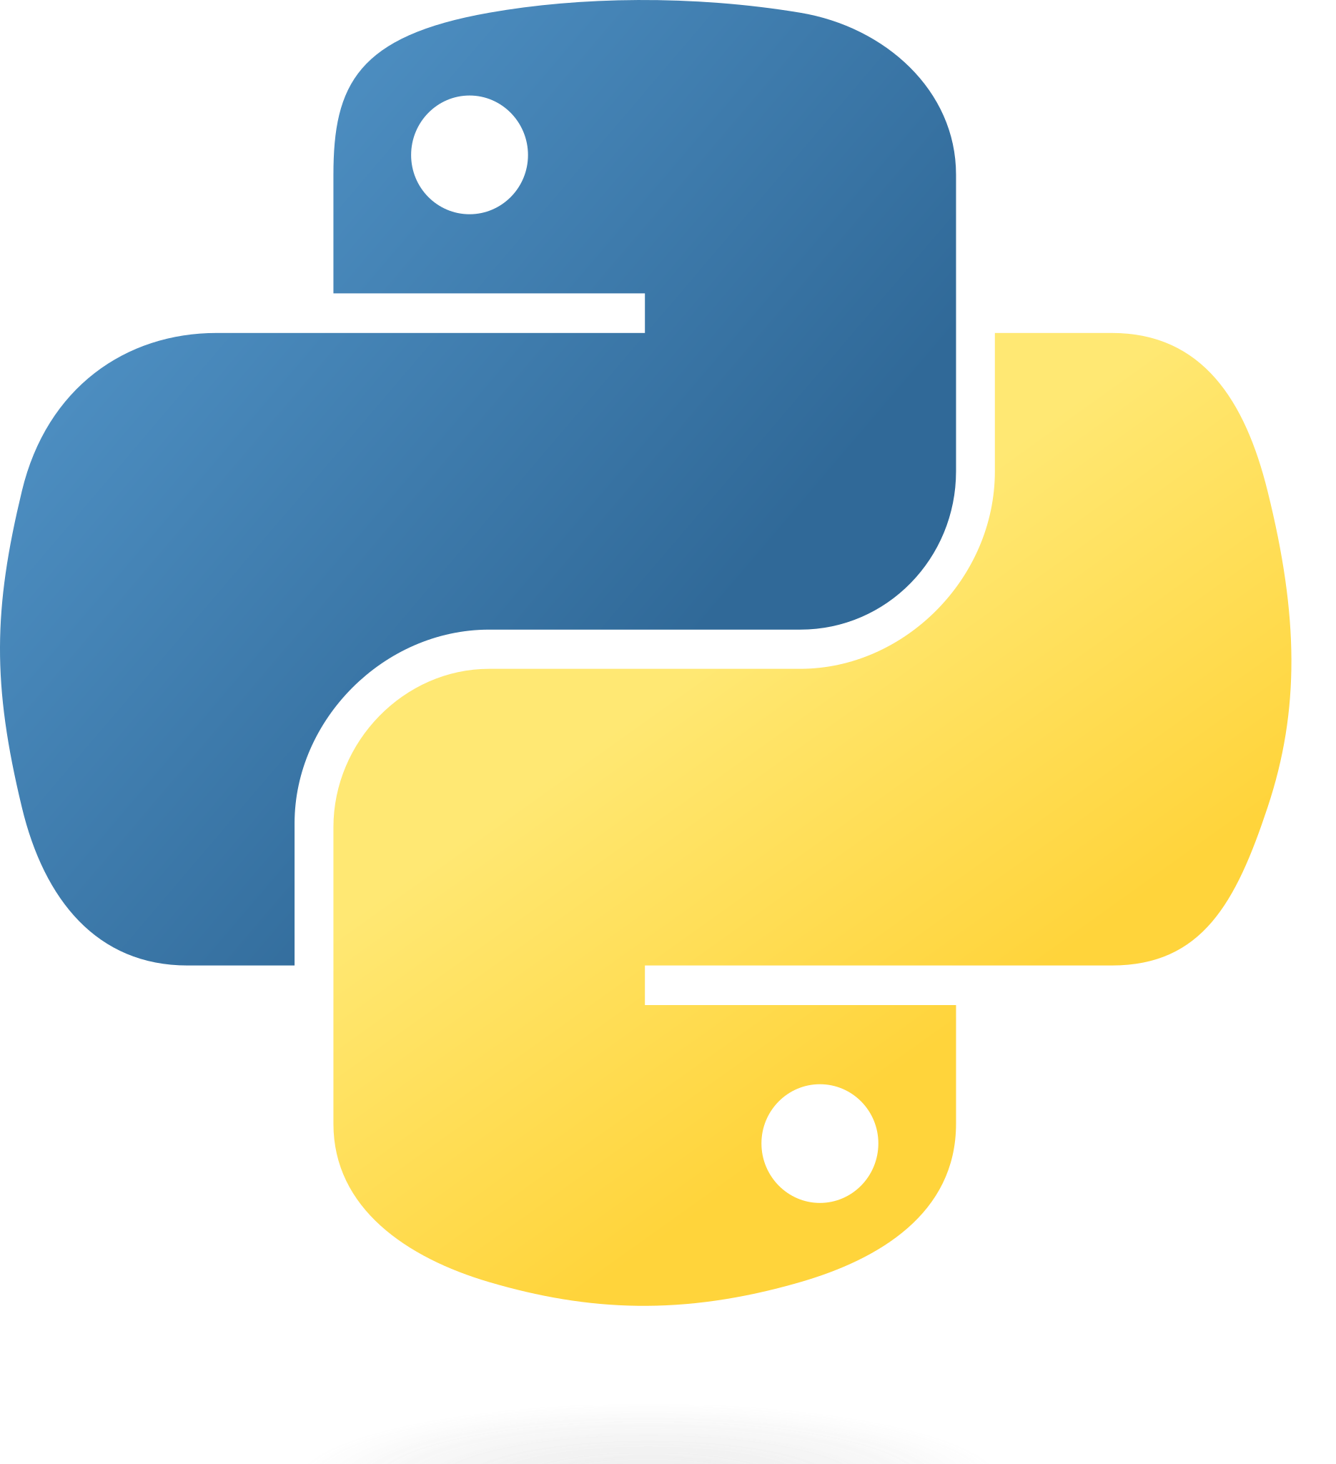
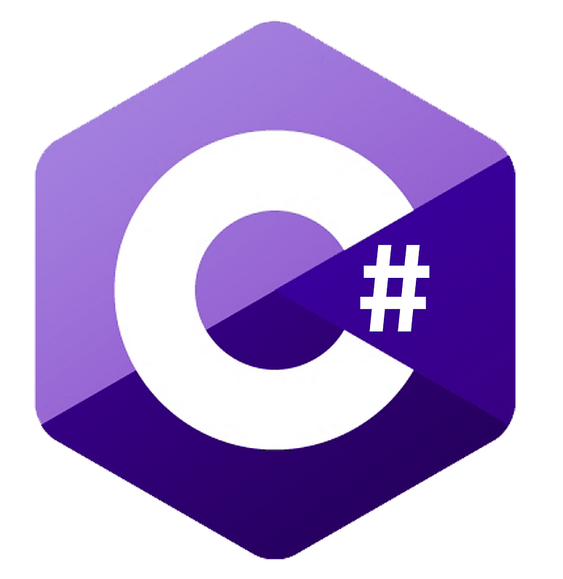
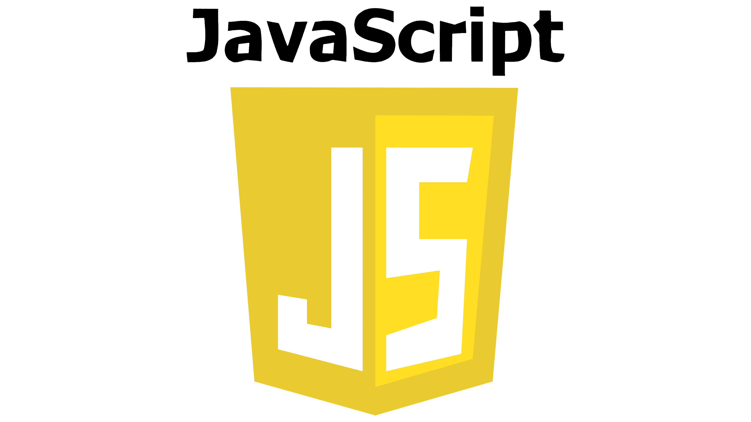
Executive Summary
Background
Boeing is evaluating Amazon Web Services (AWS) CodeWhisperer through a Proof of Concept exercise with the intent of implementing the tool in various business operations.
Goal
To validate and understand the use cases and terms of service of the tool while also measuring the efficiency of the code generated
Objective
Test several use cases and quantify the impact on accuracy and productivity across different functions within various software engineering teams, looking at its applicability within an operational context. Also, identify the critical safety concerns and potential hazards.
Scope
Programming Languages Tested
25+ Users
(US and BIETC)
Teams from IT&DA M&Q, DPACS, Software Engineering, and BR&T Math
Approval from ISC and Legal for Boeing Code
Learnings
Terms: AWS service terms recommends against using Code Whisperer in safety critical scenarios. Not a big surprise but limits potential for fly away software based on legal’s guidance
Features: Emerging interest in feature set associated to AI assisted code conversion. Take an old language and convert to something new. Not currently supported but AWS is aware of need

Slide 3
Timeline and Next Steps
Early October
Mid October
Mid to late October
2 hour immersion day w/ AWS to help accelerate the use of CodeWhisperer best practices w/ some emphasis on Prompt Engineering
Initial assessment of efficiency gains
suggestions accepted
compare between users with and without CW
looking at potentially increased effectiveness of more junior developers and increased speed for senior developers
Begin to wrap up PoC and Publish ASD artifacts
** POC was started without permission to use real Boeing application code and data with Code Whisperer which ultimately delayed efforts and evaluation by 1-1.5 months.**
Roadmap
Continue to define and identify Terms of Use and Key Features
AWS looking into providing support for Terraform (Q4)
Reach out to more teams to understand their use cases and productivity while using the Code Whisperer tool

Slide 4

AWS CodeWhisperer – Performance Metric KPI (TBD Proposal)
Objective Example
Target two teams each working integrations to SAP with Java. One team will use CW and one will not. We will measure roughly overall time to complete iteration commitment. We will also measure number of CW suggestions accepted and lines of code generated.
Team 1 – AWS CodeWhisperer
Time to Completion | 00
Code Suggestions | 00
LOC Generated | 00
LOC Developed | 00
Team 2 – Normal Development
Time to Completion | 00
Web Searches | 00
LOC Copied | 00
LOC Developed | 00
80%
50%

Slide 5
AWS CodeWhisperer – POC FAQ
How long will we consider this POC to be active. 7-9 weeks
Is there an ESATS waiver for this effort? Yes - #3629461
Is anyone else looking at CodeWhisperer in parallel? Yes, Software Engineering via Chad Beaudin. Working to a similar timeline as us in Applied Insight
Has anyone engaged legal? Yes – Weiss Nusraty from legal is aware of the activity and can provide guidance.
What data can I use? Presently please do not use for ITAR sensitive source code or source code that is safety critical (e.g. fly away)
Did we go through FFU? Not for CodeWhisperer specifically. This capability is associated to the AWS Enterprise External Cloud’s FFU and was approved through the ECS Technical Review Board.
How will we evaluate CodeWhisperer? In progress. But, broadly speaking we will evaluate in three areas: “Technology Features”, “Efficiency Gains”. Outside of POC we will also look at Terms.
Who can we work with at AWS? Eujon Sellers
Any workshop available? Yes, reference https://catalog.us-east-1.prod.workshops.aws/workshops/6838a1a5-4516-4153-90ce-ac49ca8e1357/en-US

Slide 6
Code Whisperer POC – Setup Instructions
Prerequisite: Assumes you have VSCode already installed on your machine
Download and Install Code Whisperer VSCode Extension
Download VS Code w/ AWS Toolkit or Download VSCode Extension from SRES
Configuration
Set up Azure Account (yes, Azure – account syncs to AWS)
Go to email and search for "Your Dev Account Information" and follow steps to setup
Set up the Azure account with the creds from Setup account email. It will prompt to change the password (you do not need Gitlab access referenced here)
Set up Authentication through App or phone.
Set up AWS Connection
Open VS Code command pallet using F1 or Shift+Command+P or Ctrl+Shift+P
Enter command AWS: Add a New Connection into the search field
Select it to open the Connect to AWS new connection User interface (UI).
Set up AWS Explorer and/or CodeWhisperer
On Select a feature to add a connection click AWS Explorer: View, modify, and deploy AWS Resources
On Left hand side window will appear, all the way down see section IAM Identity Center
Add Start URL as https://eecdev.awsapps.com/start#/
Select Region as us-west-2
Then Sign in
First pop-up select Copy to copy code and proceed and Past somewhere safe. Example code CDCD-EWJQ
Second pop-up select Open and enter copied code above from first pop-up
It will then forward to Microsoft login and then login with [**********@dev-digitalaviationcloud.com]
It will then forward to a new window Allow AWS Toolkit for VS Code to access your data? and then select Allow
You can now close the window and if you go back to VS Code, it should say Connected to IAM Identity Center
On Select a feature to add a connection click CodeWhisperer: AI-powered code suggestions
Follow above steps from i to ix
Opting out of sharing your client-side telemetry
In VS Code, choose the AWS logo from the side of the window. The AWS panel will open.
Under Developer tools choose the gear icon next to CodeWhisperer.
If you are using VS Code workspaces, switch to the Workspace sub-tab. In VS Code, workspace settings override user settings.
In the Settings tab search for aws:telemetry.
Uncheck the box Enable AWS Toolkit to send usage data to AWS
References
AWS Toolkit for Visual Studio Code

